Slide 1
AI-Powered Website Trust Evaluation Tools for Modern Cybersecurity
Developed under the Cybersecurity Internship Program – Digisuraksha Parhari Foundation Presented by: Saurabh Adivrekar & Ananya Shetty

Slide 2
Abstract:
In today's digital world, the proliferation of phishing websites, malicious domains, and fraudulent SSL certificates presents a significant threat to users and organizations alike. This research paper introduces a unified platform of tools developed during a cybersecurity internship under the Digisuraksha Parhari Foundation. The platform includes a Reputation Checker, Phishing Detector, Domain Age Checker, SSL Validator, Malware Scanner, and WHOIS Lookup. The goal is to empower users with tools that leverage data analysis and AI to assess the legitimacy and safety of websites. This paper discusses the tools' design, implementation, and potential impact on cybersecurity.

Slide 3
Introduction to Web-Based Threats
Overview:
Websites have become essential for online communication, transactions, and services. The internet, while incredibly powerful and transformative, has also become a playground for cybercriminals. Each day, thousands of phishing websites, malicious domains, and fake SSL certificates are launched to deceive users and steal sensitive information. These threats have grown smarter—often appearing legitimate to the untrained eye.
Users, especially those from non-technical backgrounds, need tools that can help them make informed decisions about whether to trust a website.AI tools analyze patterns, behavior, and data points to detect and flag malicious websites before they can harm users.

Slide 4
Problem Statement
Despite the availability of cybersecurity tools, most existing solutions operate in isolation. One might scan a domain’s reputation using a certain tool, then have to manually check the SSL certificate, and then maybe run a phishing detection elsewhere. This fragmented experience is inefficient and leaves room for human error.
There is a clear need for a unified, AI-driven platform that performs all essential checks in one place, quickly and accurately, to protect users from malicious websites.

Slide 5
Objectives of the Project
This project aims to create a comprehensive trust evaluation system that allows users to check the safety of any website using six key tools. The goal is to reduce the chances of phishing, fraud, and malware infections by providing actionable and real-time trust signals.
Through a smart combination of data sources, machine learning, and cybersecurity APIs, the platform empowers users to make confident decisions online.

Slide 6
Architecture Overview
The system follows a modular architecture:
The user submits a website URL.
Backend APIs and ML models are triggered to analyze different trust signals.
Results from all tools are combined and displayed via a user-friendly web interface.
Technologies used include Python (Flask), HTML/CSS/JS, Scikit-learn for phishing detection, and APIs like WHOIS, VirusTotal, SSL Labs, and Google Safe Browsing.

Slide 7
Reputation Checker
The Reputation Checker tool evaluates the overall trustworthiness of a domain. It queries public reputation databases and platforms like PhishTank and Google Safe Browsing to determine whether the URL has been reported or flagged before.
By assigning a safety score—ranging from Safe to Suspicious to Dangerous—the tool gives users a quick overview of whether they should proceed to the site.

Slide 8
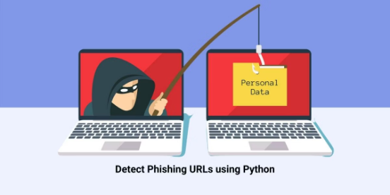
Phishing Detector
This is the AI-driven core of the platform. The Phishing Detector analyzes both the URL structure and parts of the website’s HTML content using a trained machine learning model (Decision Tree Classifier).
The model was trained on a dataset of known phishing and legitimate websites and achieved an accuracy rate of 92% during testing. It helps flag websites that are likely trying to deceive users, even if they visually resemble real ones.

Slide 9
SSL Validator & Domain Age Checker
Many phishing sites use free, self-signed, or recently issued SSL certificates. The SSL Validator tool checks whether the SSL certificate is valid, who issued it, and whether it's expired. Sites with poor or invalid certificates are immediately flagged.
Alongside this, the Domain Age Checker uses WHOIS data to reveal when the domain was registered. Most malicious websites are short-lived; thus, very new domains raise red flags. Together, these tools help identify fake sites that are hiding behind a thin veil of legitimacy.

Slide 10
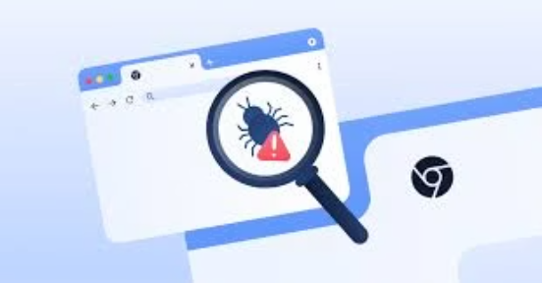
WHOIS Lookup & Malware Scanner
Transparency is a key component of trust. The WHOIS Lookup tool reveals the domain’s ownership details, registrar information, and sometimes even the location of the registrant. Domains with hidden or masked WHOIS data are more suspicious.
The Malware Scanner, integrated with the VirusTotal API, checks if the URL is linked to any known malware, trojans, or virus distributions. If blacklisted by major antivirus engines, the site is flagged as dangerous.

Slide 11
Implementation
The entire platform was developed using Python (Flask) for the backend, along with HTML, CSS, and JavaScript for the frontend. Integration with multiple APIs enabled real-time scanning and data collection. The phishing detector was trained using the Scikit-learn library.
Performance optimization was a key focus. Each tool was designed to return results in under 2 seconds, allowing for a smooth user experience.

Slide 12
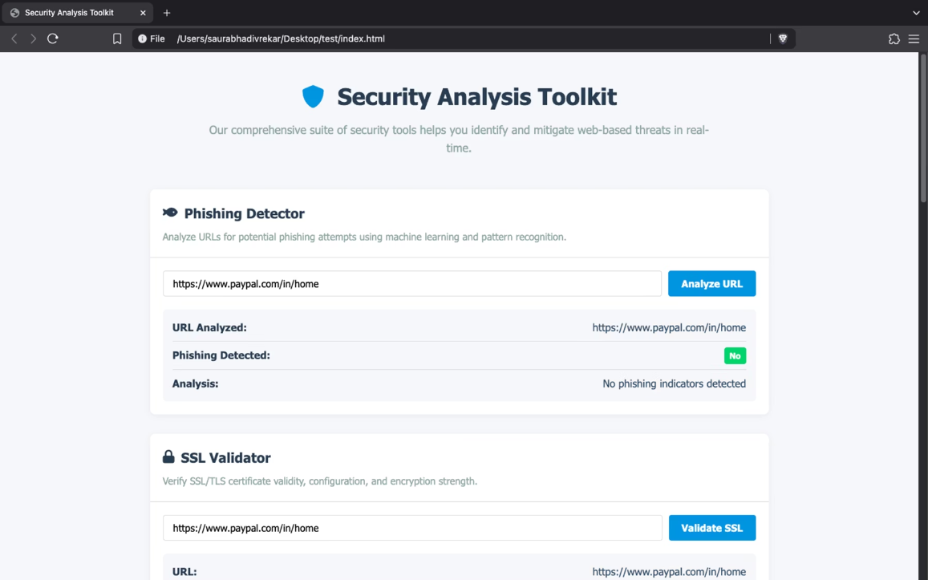
Demo Screenshots

Slide 13
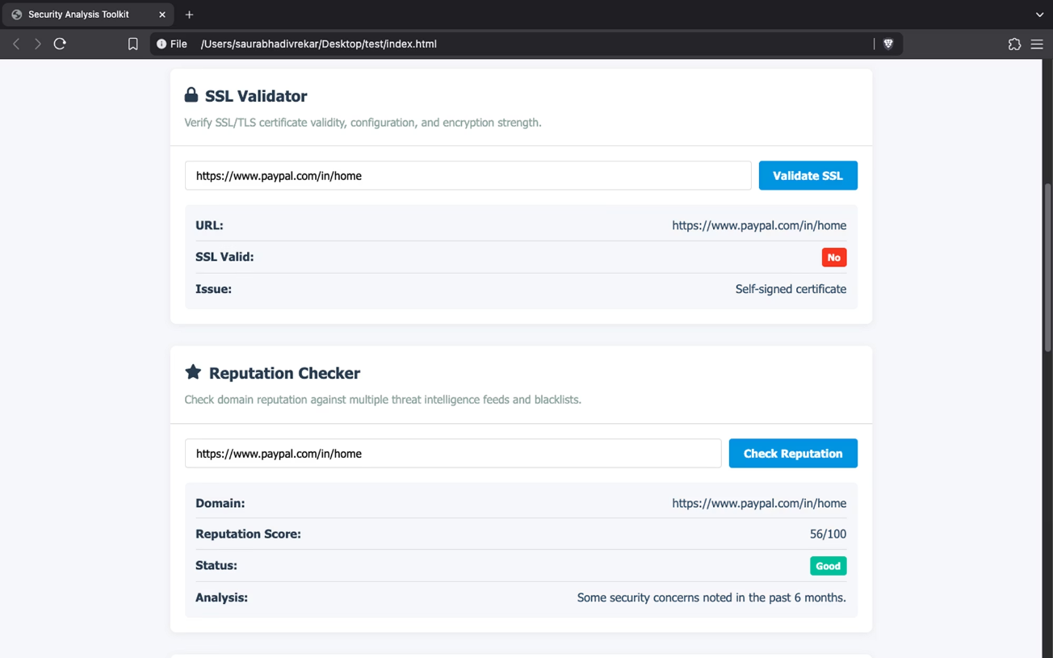

Slide 14
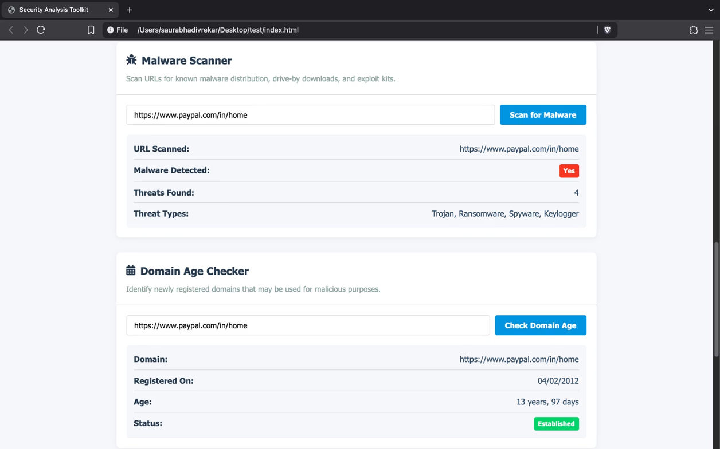

Slide 15
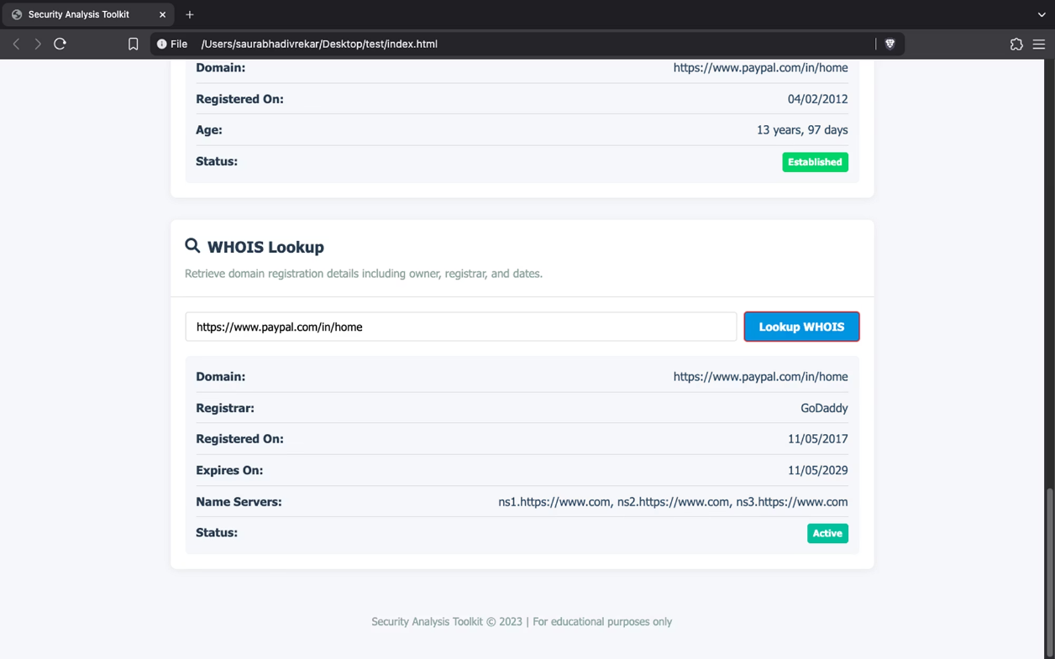

Slide 16
Real-World Use Cases
This tool is designed for both technical and non-technical users. It is particularly useful in the following contexts:
Small businesses can verify vendor websites before making payments.
Journalists and activists can check the authenticity of sources.
Educators and students can use it as a learning tool to recognize phishing.
Everyday internet users can quickly validate suspicious links before clicking.

Slide 17
Ethical Impact
By giving users the power to analyze website trustworthiness, the platform encourages ethical behavior and data protection. It helps prevent fraud, misinformation, and the spread of malware by acting as an early warning system.
Moreover, it promotes digital literacy and safe browsing habits without requiring users to rely solely on expensive enterprise tools.

Slide 18
Future Scope
The platform can evolve in several meaningful ways:
Integration with browsers as an extension for real-time analysis while browsing.
Development of a lightweight mobile app version.
Use of deep learning models (like CNNs) for more advanced phishing detection.
Implementation of dark web scanning to detect if a domain is being discussed or abused in underground forums.
Real-time email or SMS alerts when threats are detected.

Slide 19
References
Anti-Phishing Working Group Reports (2023)
ICANN WHOIS Accuracy Program (2021)
VirusTotal API Documentation
Scikit-learn ML Library
SSL Labs Documentation
"Detecting Malicious Domains Using Machine Learning," IEEE 2022
OWASP Threat Modeling
NIST Cybersecurity Framework
PhishTank Dataset
Google Safe Browsing API Docs

